Slide 1


2026-2027 Rising Junior Course Selection
^{Class of 2027 - Rising Juniors}

Slide 2
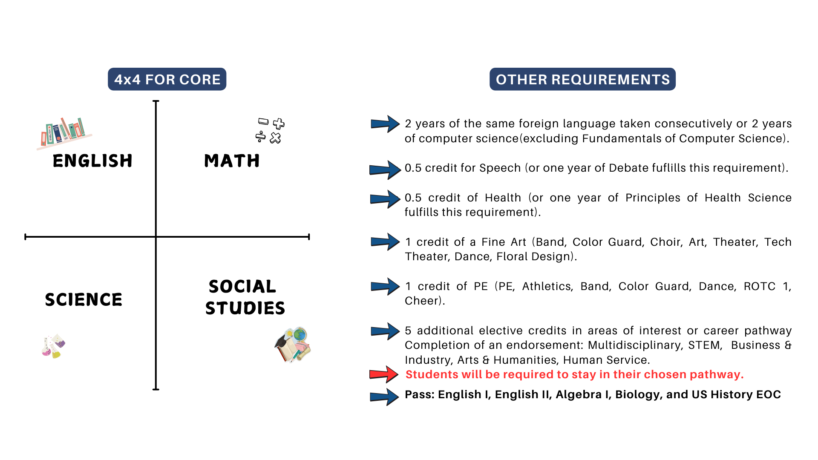
Graduation requirements

Slide 3

Class Rank Policy
Class rank will be calculated for ALL students, but it will not be on the transcripts. A rank letter will be uploaded into your Skyward Portfolio, along with your transcript.​ It will also be available in Schoolinks.
Senior year, students will choose to send their rank to colleges or not. The rank letter can be shared with colleges if students choose to share their rank.​
GPA will continue to be calculated for all students and will be on the transcripts.​

Slide 4




What does it mean to be college ready?
Postsecondary Goal
No Remediation Needed
Industry Certificate
A student who is “college ready” is prepared for any postsecondary goal without the need for college remediation. The student meets the minimum Texas Success Initiative scores through the SAT, ACT, or TSIA.
Students who are college ready can enroll in entry-level, credit-bearing college courses without the need for remedial or developmental education.
The student has completed or is working towards an industry certificate or has met TSI benchmark through SAT, ACT, or TSIA

Slide 5
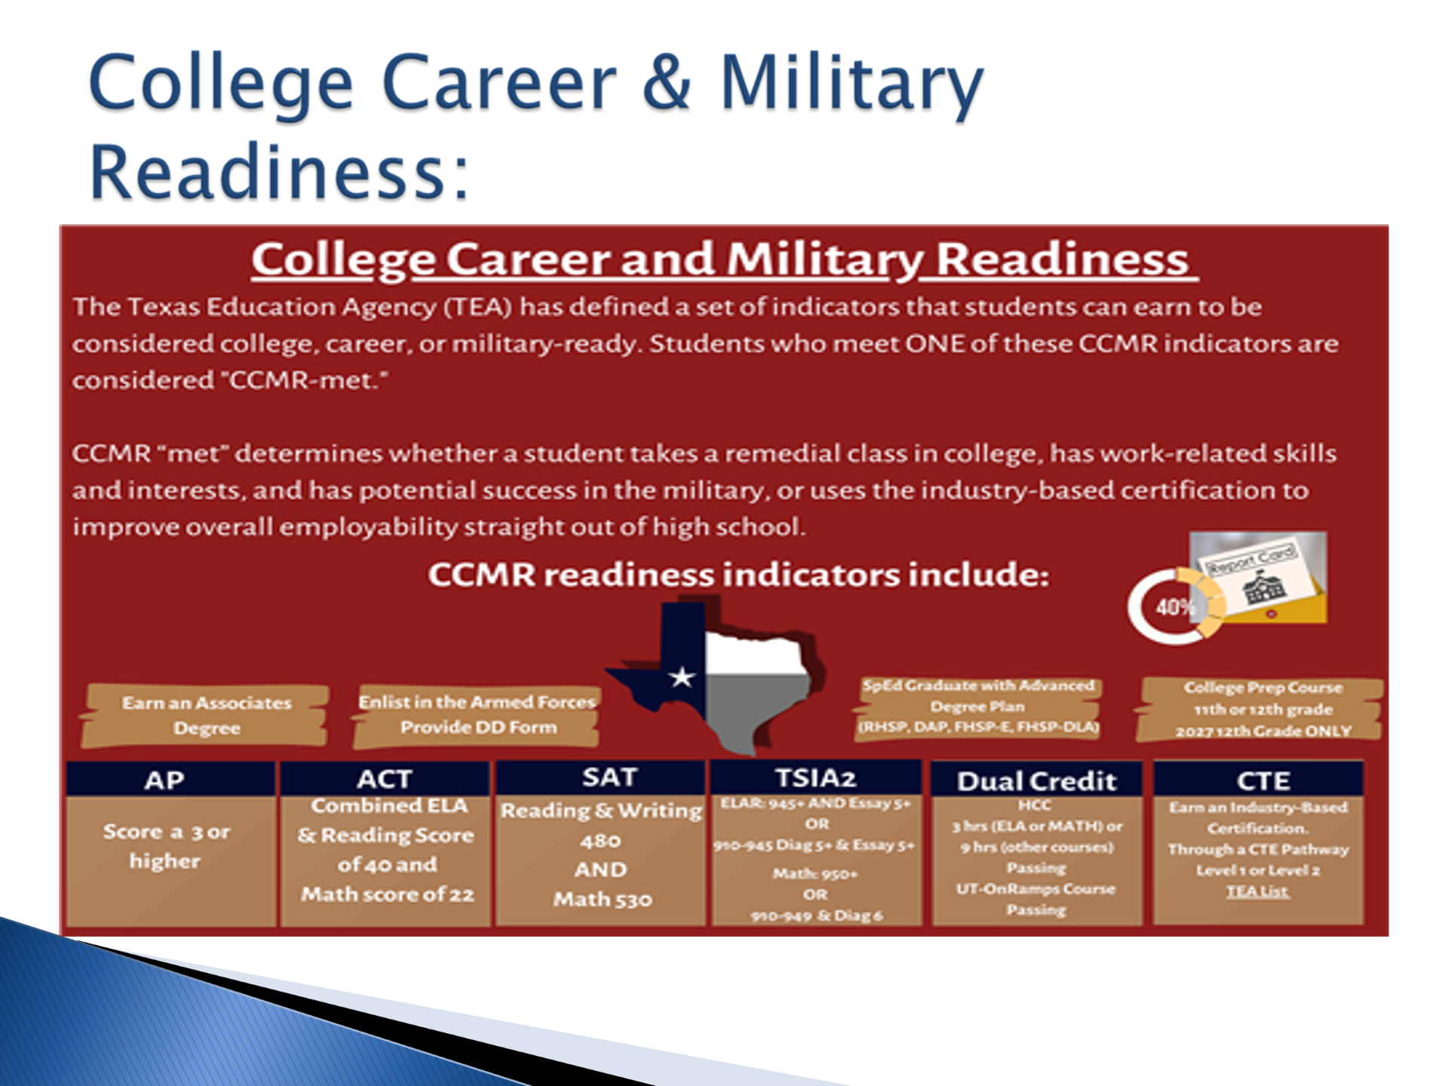
How do I know if I am ccmr ready

Slide 6

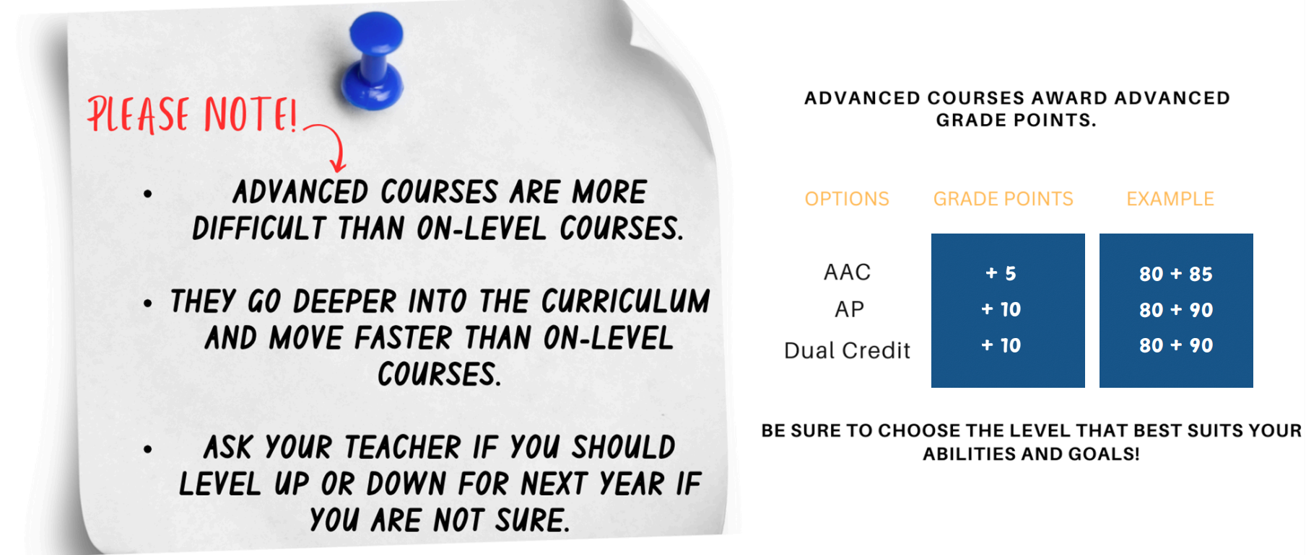
Should I take AAC, AP, or DC?

Slide 7





Need to Knows!
Level Down Approval
Level downs will not be approved until the 4th week of school
Minimum Grade for Level Down
Students must have a grade below 75.​
Level Up Approval
Level ups – must be done immediately!​
AB Calculus​ - BC Calculus (cannot level down after S1 to AB) -​ Multivariable Calculus - Anatomy – Forensics - AP Biology​ - AP Chemistry​ - Physics C​ - Physics 2​ - Levels 3, 4 and 5 of Foreign Language​ - Computer Science courses​ - AP Seminar and AP Research -​ & - Decathlon (called Multidisciplinary Studies)
​Choosing any of these courses is a full year commitment.​
Courses with No Level Changes

Slide 8
Summer Courses
Grade Reporting
Students will NOT be moved into their next course for Fall until the grade report has been submitted. For example, all of geometry must be completed by end of July or you will not be moved into Algebra 2.​
***Deadline for summer courses is the same as the last day of the face-to-face summer school.
Online Courses
Students may enroll in summer courses through UT or TTU online high schools, TxVSN or Dual Credit with HCC.
Restrictions
Associated Costs
Algebra 2 and Pre-Calculus will NOT be approved.
There are costs associated with these summer courses.
Approval Required
All online courses must be approved by your counselor prior to enrolling in course(s). Request approval through Skyward. Check Skyward for approval or denial.
Academy Students
Application Timeline
Academy students will not be approved for math, science or computer science. These must be taken on campus as per the Academy.​
Time Commitment
Summer application will open later in Spring, we do not have any information at this time about summer courses.
These courses must be completed by end of summer, which means logging in 4-5 hours each day!

Slide 9
Course Changes, New Courses, & Updates
Deadline for all online summer courses will be the last day of face- to-face summer school.
Various performing Fine Arts will be weighted as AAC level.
Students that want to take AP Seminar will be required to take the AP exam. Students and parents must sign a contract in order to be placed into the course agreeing that they will take the AP exam.

Slide 10



Dual Enrollment - UT OnRamps
Dual Enrollment Basics
Inquiry-Based Learning
Course Options
Students earn both high school and college credit through UT OnRamps. These courses are weighted at the AP level. Currently there is no cost for these courses.
**No forms required, just choose course on course selection sheet.
UT OnRamps courses utilize an inquiry-based learning approach, which is student-driven rather than teacher-driven. This non-traditional learning style may not be suitable for everyone, so students should choose wisely.
The UT OnRamps course options include Algebra 2, Pre-Calculus (if Algebra 2 has been completed),Chemistry,(if you have not taken AAC Chemistry), Stats.
AAC/AP/Dual Credit/UT OnRamps Information Sheet

Slide 11
Dual Credit - HCC Courses
Dual Credit Courses for 11th Grade
Enrollment Process
Course Weighting
Please look for the email from Ms. Powis sent though SchoolLinks on 11/6/25 for the step-by-step process to enroll in these Dual Credit courses. There is required paperwork and other requirements that must be completed with HCC.
These courses are weighted as AP and are rigorous.
FBISD will now allow 11th grade students to take the following Dual Credit courses: US History, Humanities, Speech, Sociology, and Psychology.
Recommended Courses
Student Eligibility
We have many courses on our campus, we always recommend that students take DC courses on our campus with our teachers. You have the most support this way – especially if you are new to DC.
We do have the option of online DC courses in both summer and during the school year.
Counselors will review student PSAT/SAT scores to ensure students are ready for these Dual Credit courses.

Slide 12
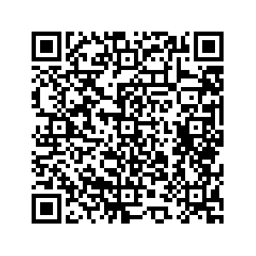
Interested in AVID?
https://forms.office.com/Pages/ResponsePage.aspx?id=QWJ9SRo5d0KRrL3SqZ9wVDMvcqdQmIBInk80grpz0VRUM1ZORllQWFZMVkQ1UzMwUFpOMzRONUQ5TCQlQCNjPTEu
Application is open now and closes on January 23rd!

Slide 13
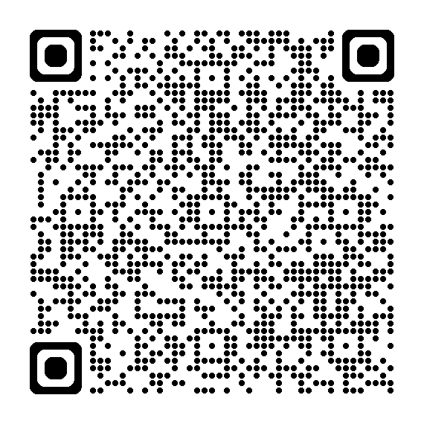
Interested in PALS?
Application is open now and will close on February 4, 2026

Slide 14
Course Selection Process
Complete course selection form
  Complete the course selection form in its entirety, listing at least 3 alternate courses. Write clearly using your full name along with your student ID number.
Use the Universal course selection sheet
  Use the Universal course selection sheet to guide you through the course selection process and make informed choices. You can access the course worksheet in Schoolinks or on the EHS Counselor webpage.
Access the FBISD Course Guide in Schoolinks
  The FBISD Course Guide located in Schoolinks, provides information on course prerequisites, descriptions, credit awarded, and how the course is weighted (AAC, AP).
Courses will be added to Career Planner in Schoolinks
  Course requests will be added to Career Planner in Schoolinks, not Skyward.
Return Forms to Counselor
  Course selection forms are to be turned into the counselor suites room 401 and 402 with parent signature.​
Schoolinks will be available from January 26 to February 13, 2026.
  What is added in Schoolinks will become your course requests.​
Course Verification Window is from March 9-13
  Verify your courses in Skyward Family Access when the window opens March 9-13. This is the only opportunity to make changes to your choices. Like this year, absolutely no schedule will be made after March 13, 2026, unless it is a counselor error.​

Slide 15
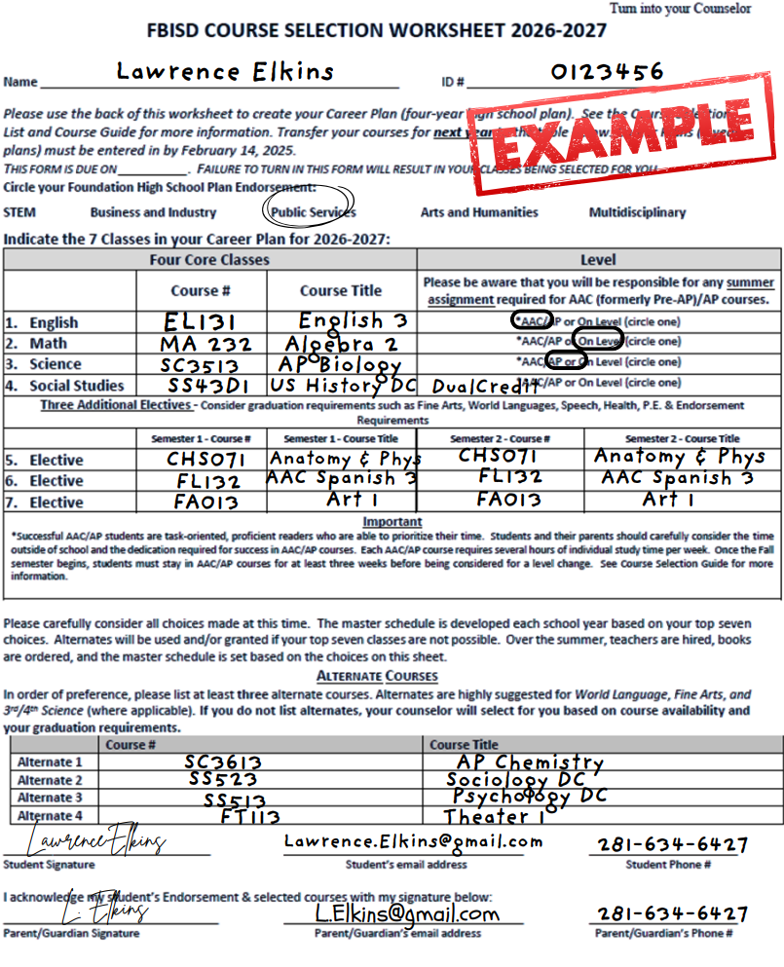
Make sure you Select 4 core courses and 3 elective courses
Please choose 3 alternate courses to complete your course selection
Be sure one of your courses is your endorsement elective

Slide 16






Reminders
Schoology Course Access
Turn in Form Immediately
This PowerPoint will be available in the EHS Counselor & CCR Schoology Course with access code 7NPB-W4H5-RVN29.
Turn in your course selection form as soon as possible in rooms 401 and 402! If you do not turn in a form and there is nothing in Schoolinks, your counselor will add courses for you!​
Course Selection
Select 4 core courses, 3 elective courses, and 3 alternate courses to complete your course selection
Be sure you have your Pathway course
we will be checking these and adding any missing courses.​
Parent Signature Required
Courses Selection Deadlines
Parent signature is required on the course selection form.
All courses must be added to Schoolinks no later than February 13, 2026.​Course Verification Window is from March 9-13.
ABSOLUTLEY NO SCHEDULE CHANGES AFTER MARCH 13, 2026!​

